Slide 1
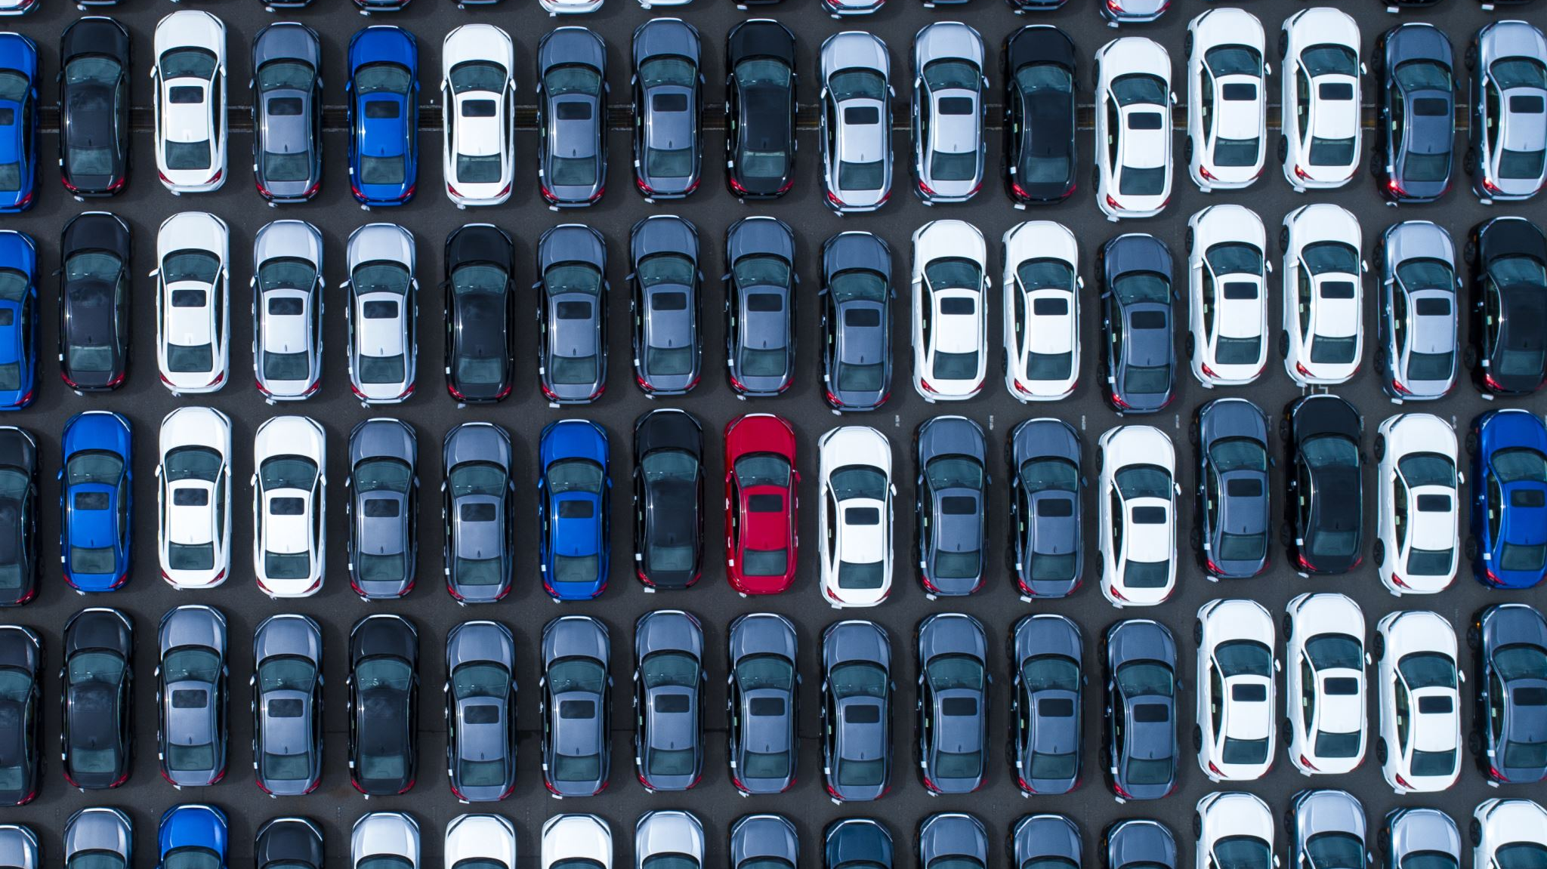
What makes a car more prone to Gas guzzling tax
By Loza Kassa

Slide 2
Data Collection and cleaning
48,000 observation
Transmission changed to manual and automatic and other.
NA in Guzzler tax variable changed to “no tax”

Slide 3
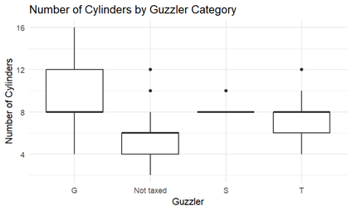
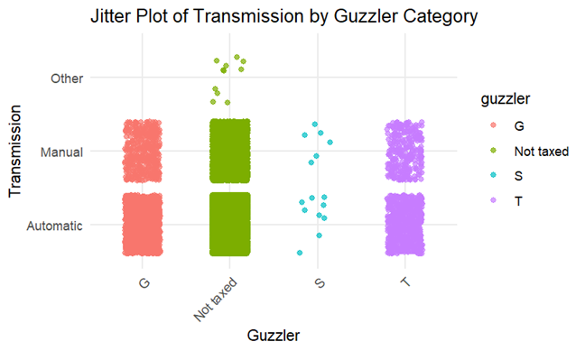
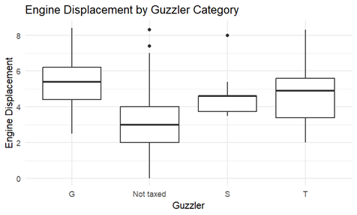
Exploratory analysis

Slide 4
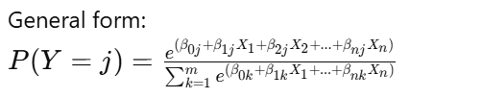
Multinomial Logistic regression
Y is the categorical response variable
Xs are predictor variables
are regression coefficients

Slide 5
Results
Model Overview:
Dependent Variable: Guzzler (Categories: Not taxed, S, T)
Independent Variables: Cylinders, Displacement (displ)
Key Results:
Intercepts:
Not taxed: 13.29 | S: -1.97 | T: 2.79
Cylinders:
Not taxed: -1.52 | S: -0.16 | T: -0.18
Displacement (displ):
Not taxed: 0.20 | S: -0.28 | T: -0.37
Standard Errors:
Not taxed: 0.22, 0.04, 0.04
S: 1.21, 0.20, 0.34
T: 0.21, 0.03, 0.06
Model Fit:
Residual Deviance: 16137.06 | AIC: 16155.06

Slide 6

Thank You

